Slide 1
電腦視覺原理及應用簡介
Lab7
PCA Ellipse Fitting

Slide 2
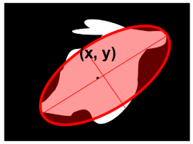
Ellipse Fitting
Fit an ellipse on an object
In order to draw an ellipse, you need to decide:
Center of the ellipse (x, y)
Rotational angle of the major axis
Length of the major axis and minor axis
Notes:
Syntax: cv2.ellipse(image, centerCoordinates, axesLength, angle, startAngle, endAngle, color [, thickness[, lineType[, shift]]])
axesLength: It contains tuple of two variables containing major and minor axis of ellipse (半長軸、半短軸長度)

Slide 3
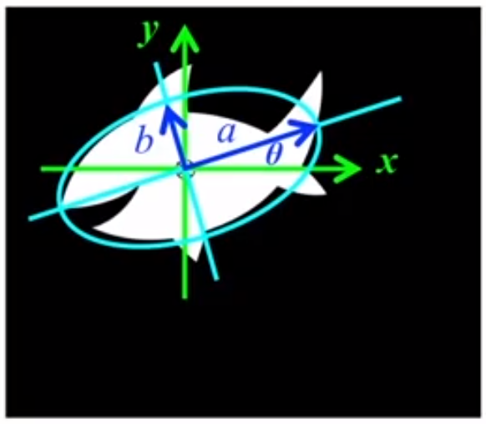


Principal component analysis
Get eigenvalues($λ_{1}$, $λ_{2}$) and eigenvectors($v_{1}$, $v_{2}$)
radii
a = c*$\sqrt{λ_{1}}$ , b = c*$\sqrt{λ_{2}}$
where $λ_{1}$ > $λ_{2}$, c is a constant
orientation
$θ$ = $\tan^{−1}{\frac{v_{y}}{v_{x}}}$
where v is the eigenvector corresponding to the largest eigenvalue

Slide 4
Assignment
將物件輪廓點做PCA後畫出橢圓、原點、物件輪廓
完成請繳交程式碼與圖片

Slide 5
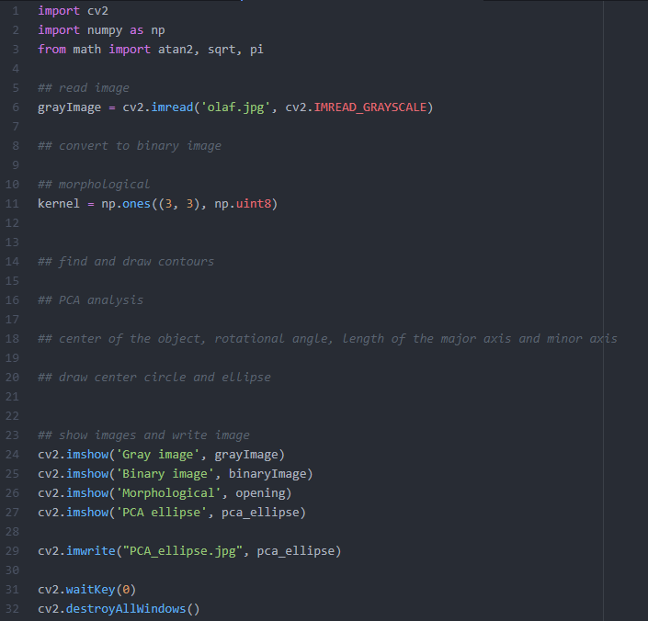
Assignment (cont.)
cv2.threshold()
cv2.morphologyEx()
cv2.PCACompute2()
atan2()
cv2.circle()
cv2.ellipse()

Slide 6
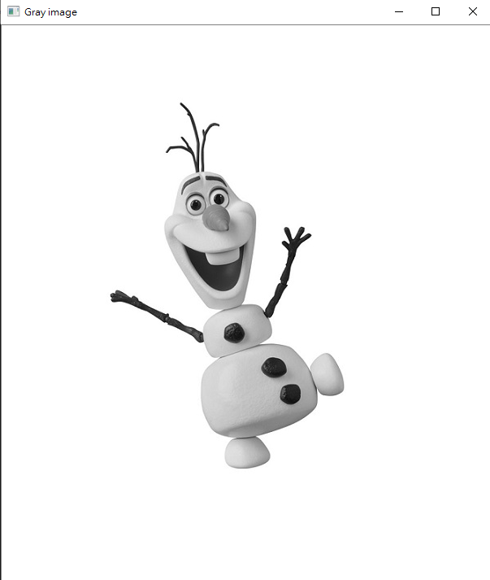
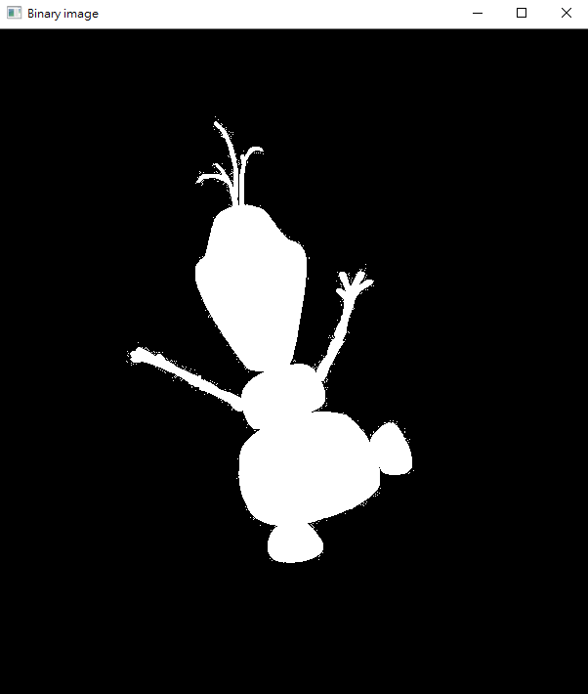
Demo

Slide 7

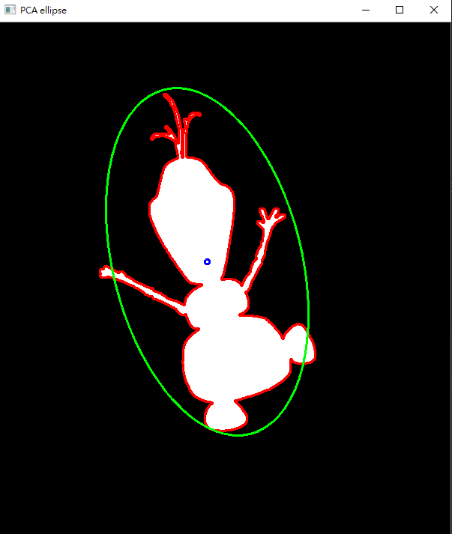
Demo

